Slide 1
Food Saver (Final Presentation)
(Team 7) Frank Dadzie Sean Robinson Javier Ortiz Junghyun Kim

Slide 2
Recap
Each year, 108 billion pounds of food is wasted in the United States. That equates to more than $408 billion in food thrown away each year.
Shockingly, nearly 40% of all food in America is wasted
Food Saver is a project meant to reduce the overall waste produced from vendors being unable to sell products before their expiration date
Vendors put up their discounted produce on Food Saver for local customers to view
Buyers select a local shop of their choosing and get information such as the location and the items being sold at a discount

Slide 3
Functional Requirements
Vendor - Create listings with image, price, description, and expiration date - Remove listings past expiration - Mark listings sold - Update store address and name Buyer - Use GPS and maps to locate local vendors - Browse catalog of local produce - Use in app vendor information for contact and directions

Slide 4
Mockups (Vendor Side)

Slide 5
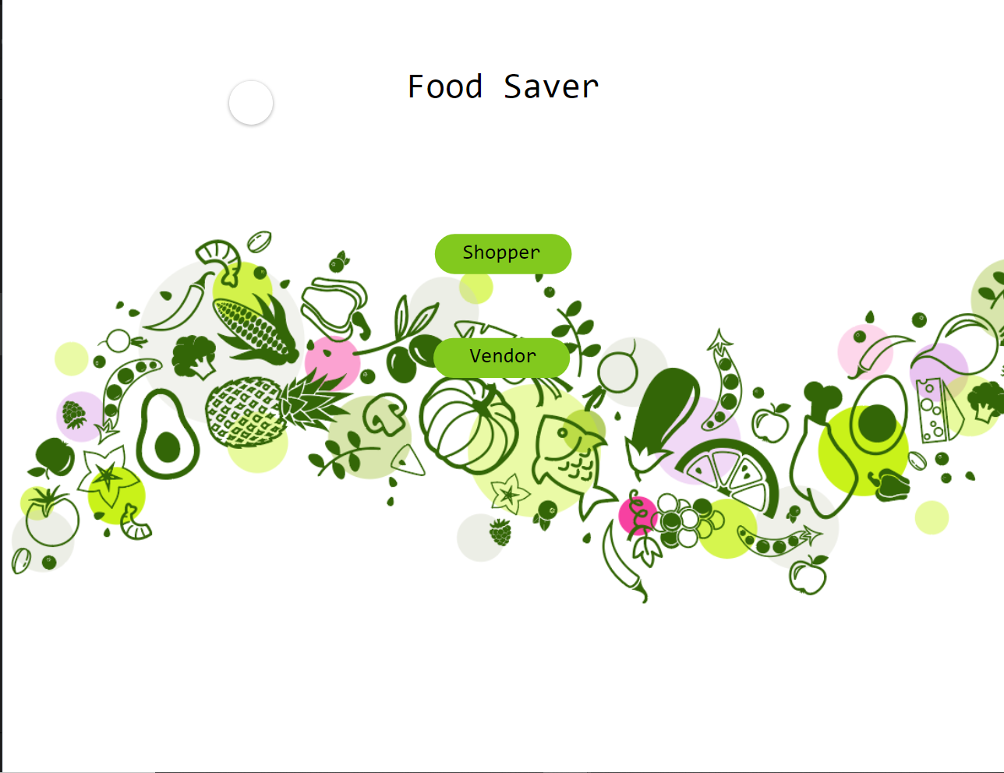
Mockups (Home Page)

Slide 6
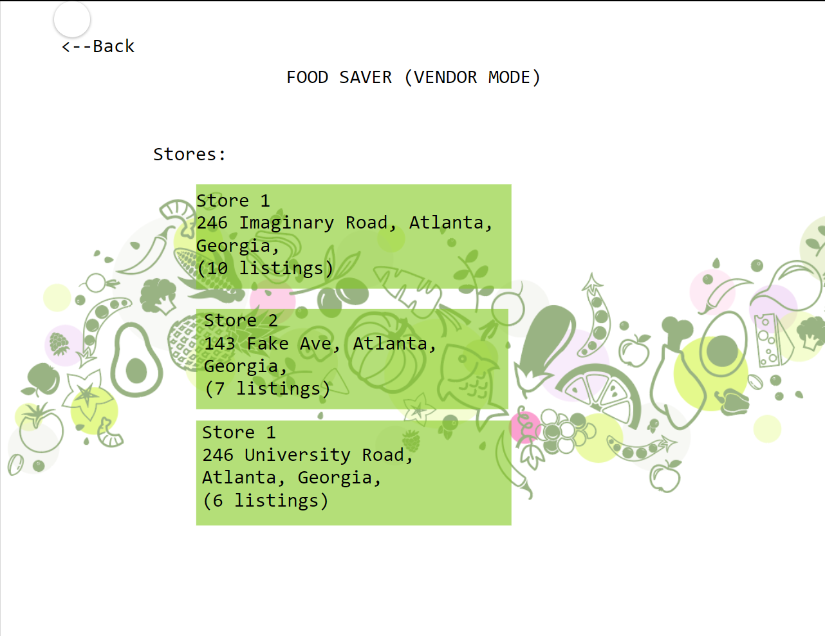
Mockups (Vendor)

Slide 7
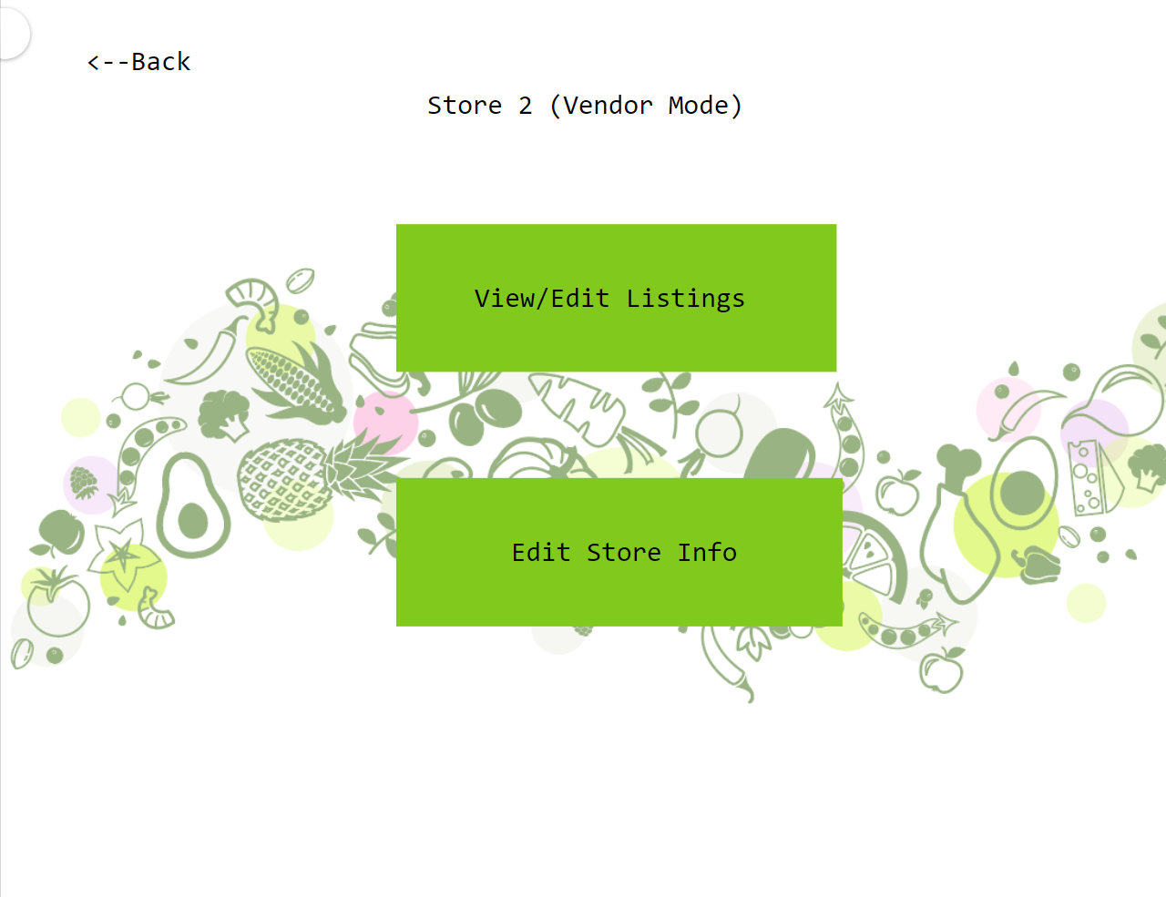
Mockup (Vendor Actions)

Slide 8
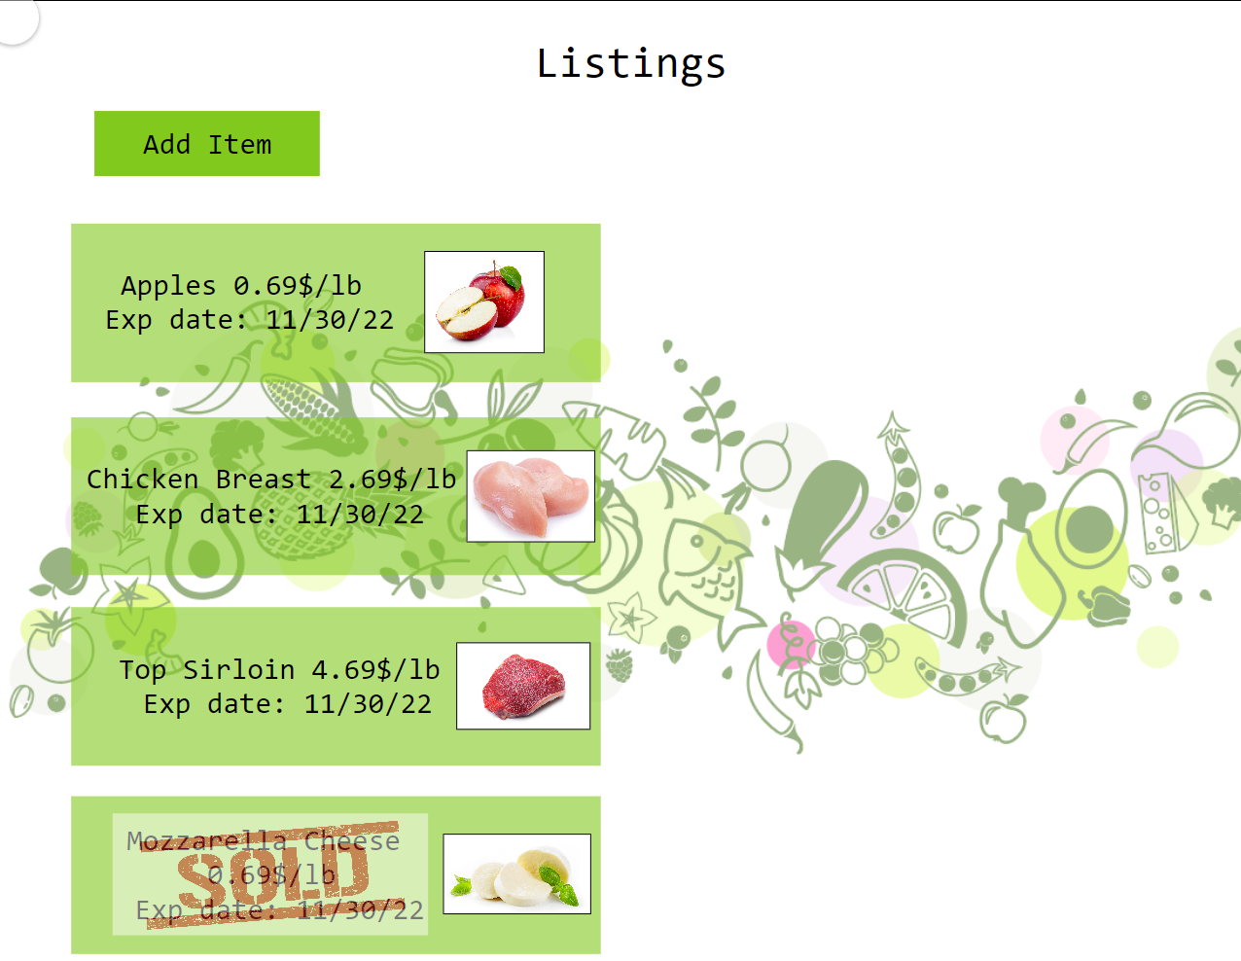
Mockup (Vendor Listings)

Slide 9
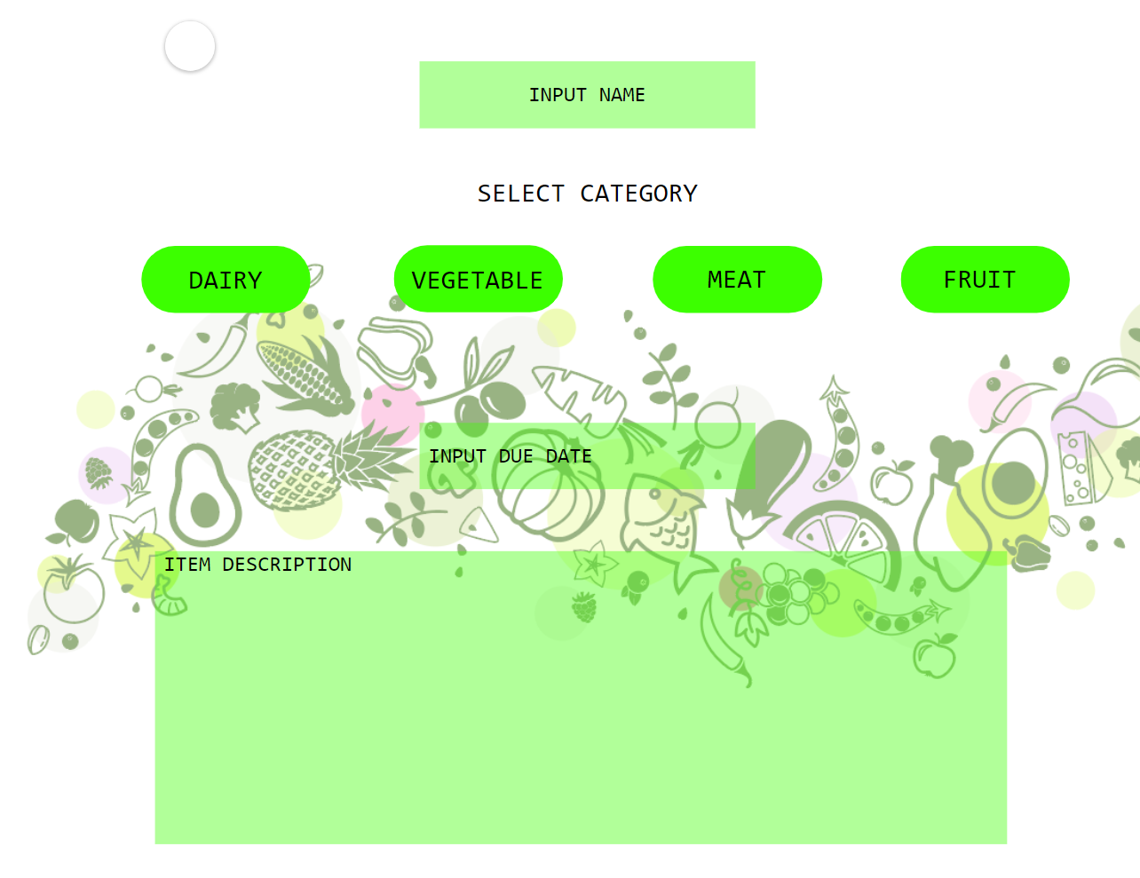
Mockups (Vendor Add Item)

Slide 10
Buyer Demonstration

